Slide 1
Subject enhancement and background blur
Image processing based on MATLAB
By

Slide 2
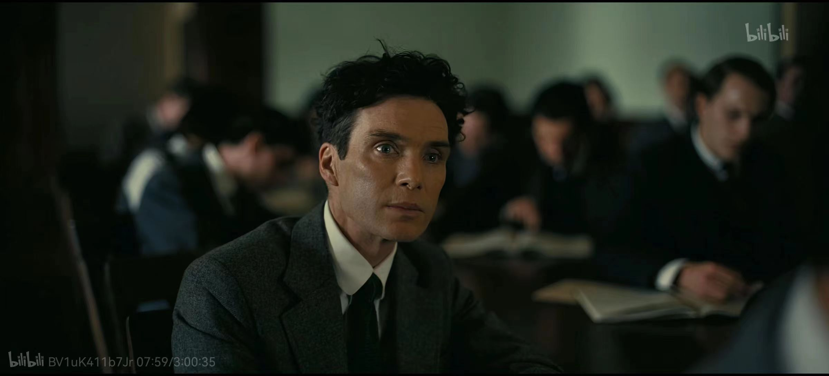
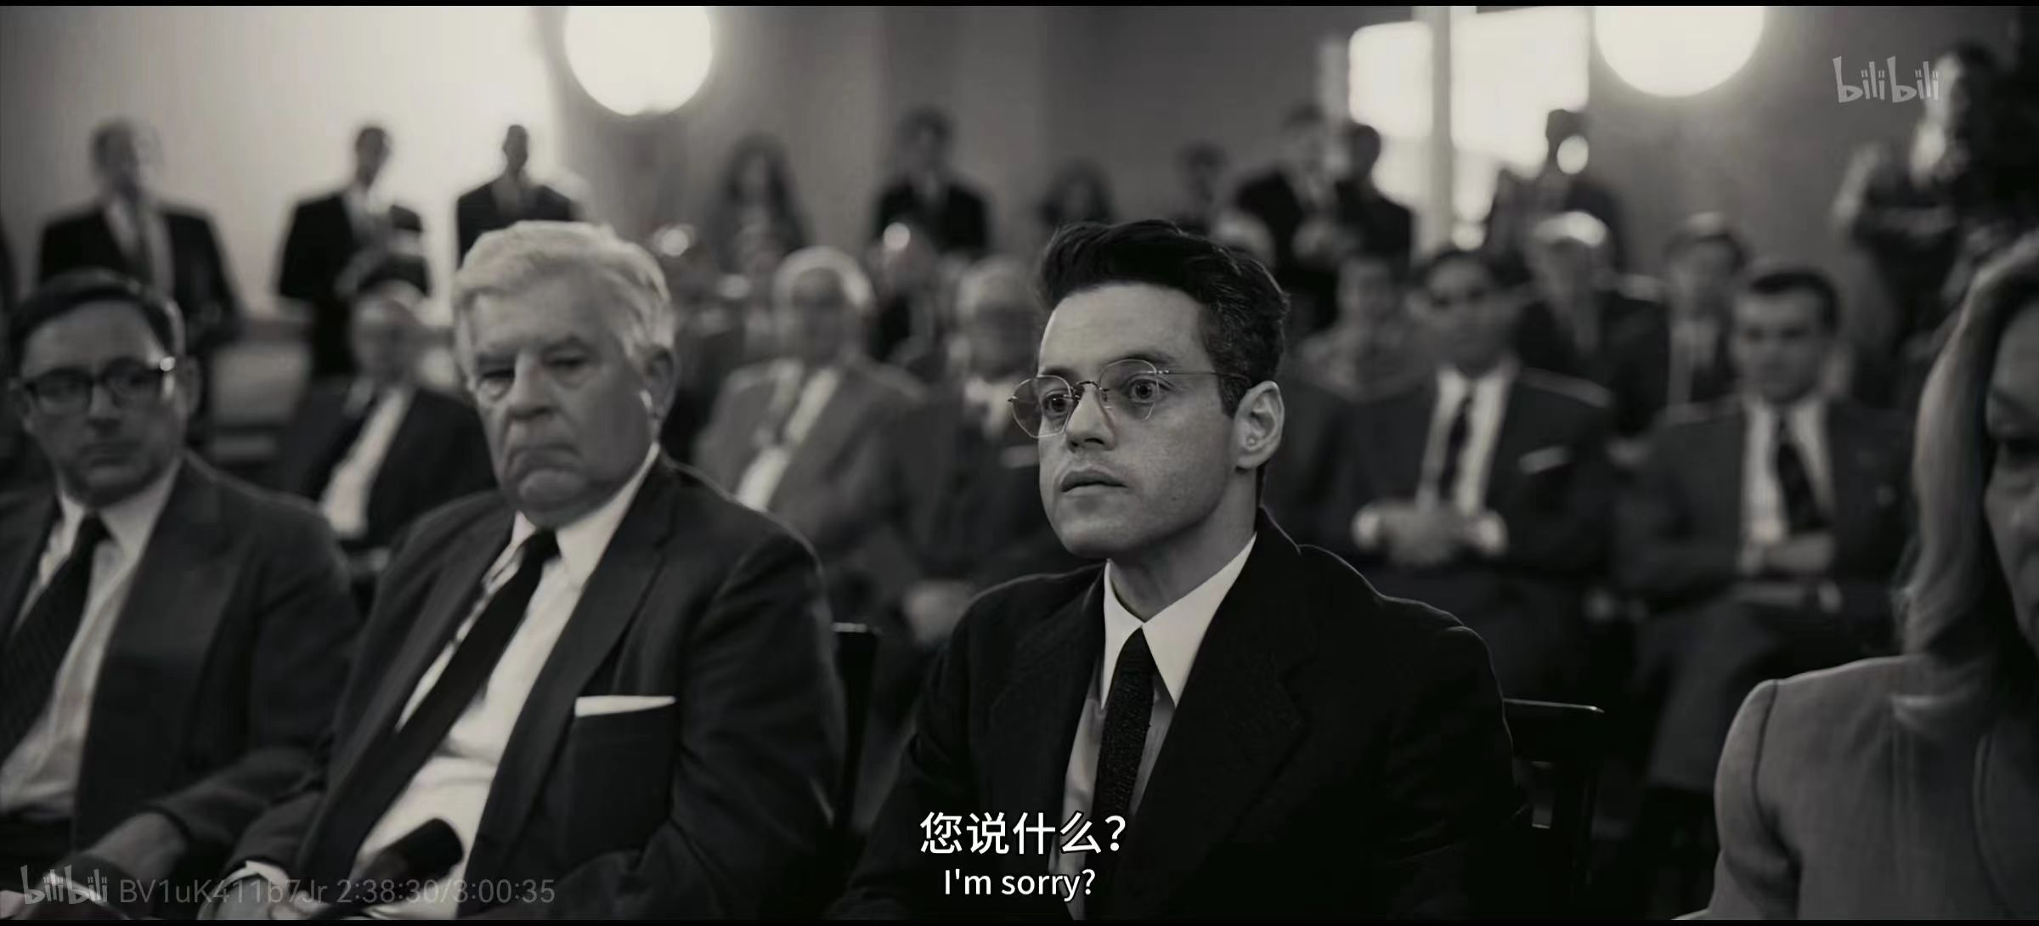
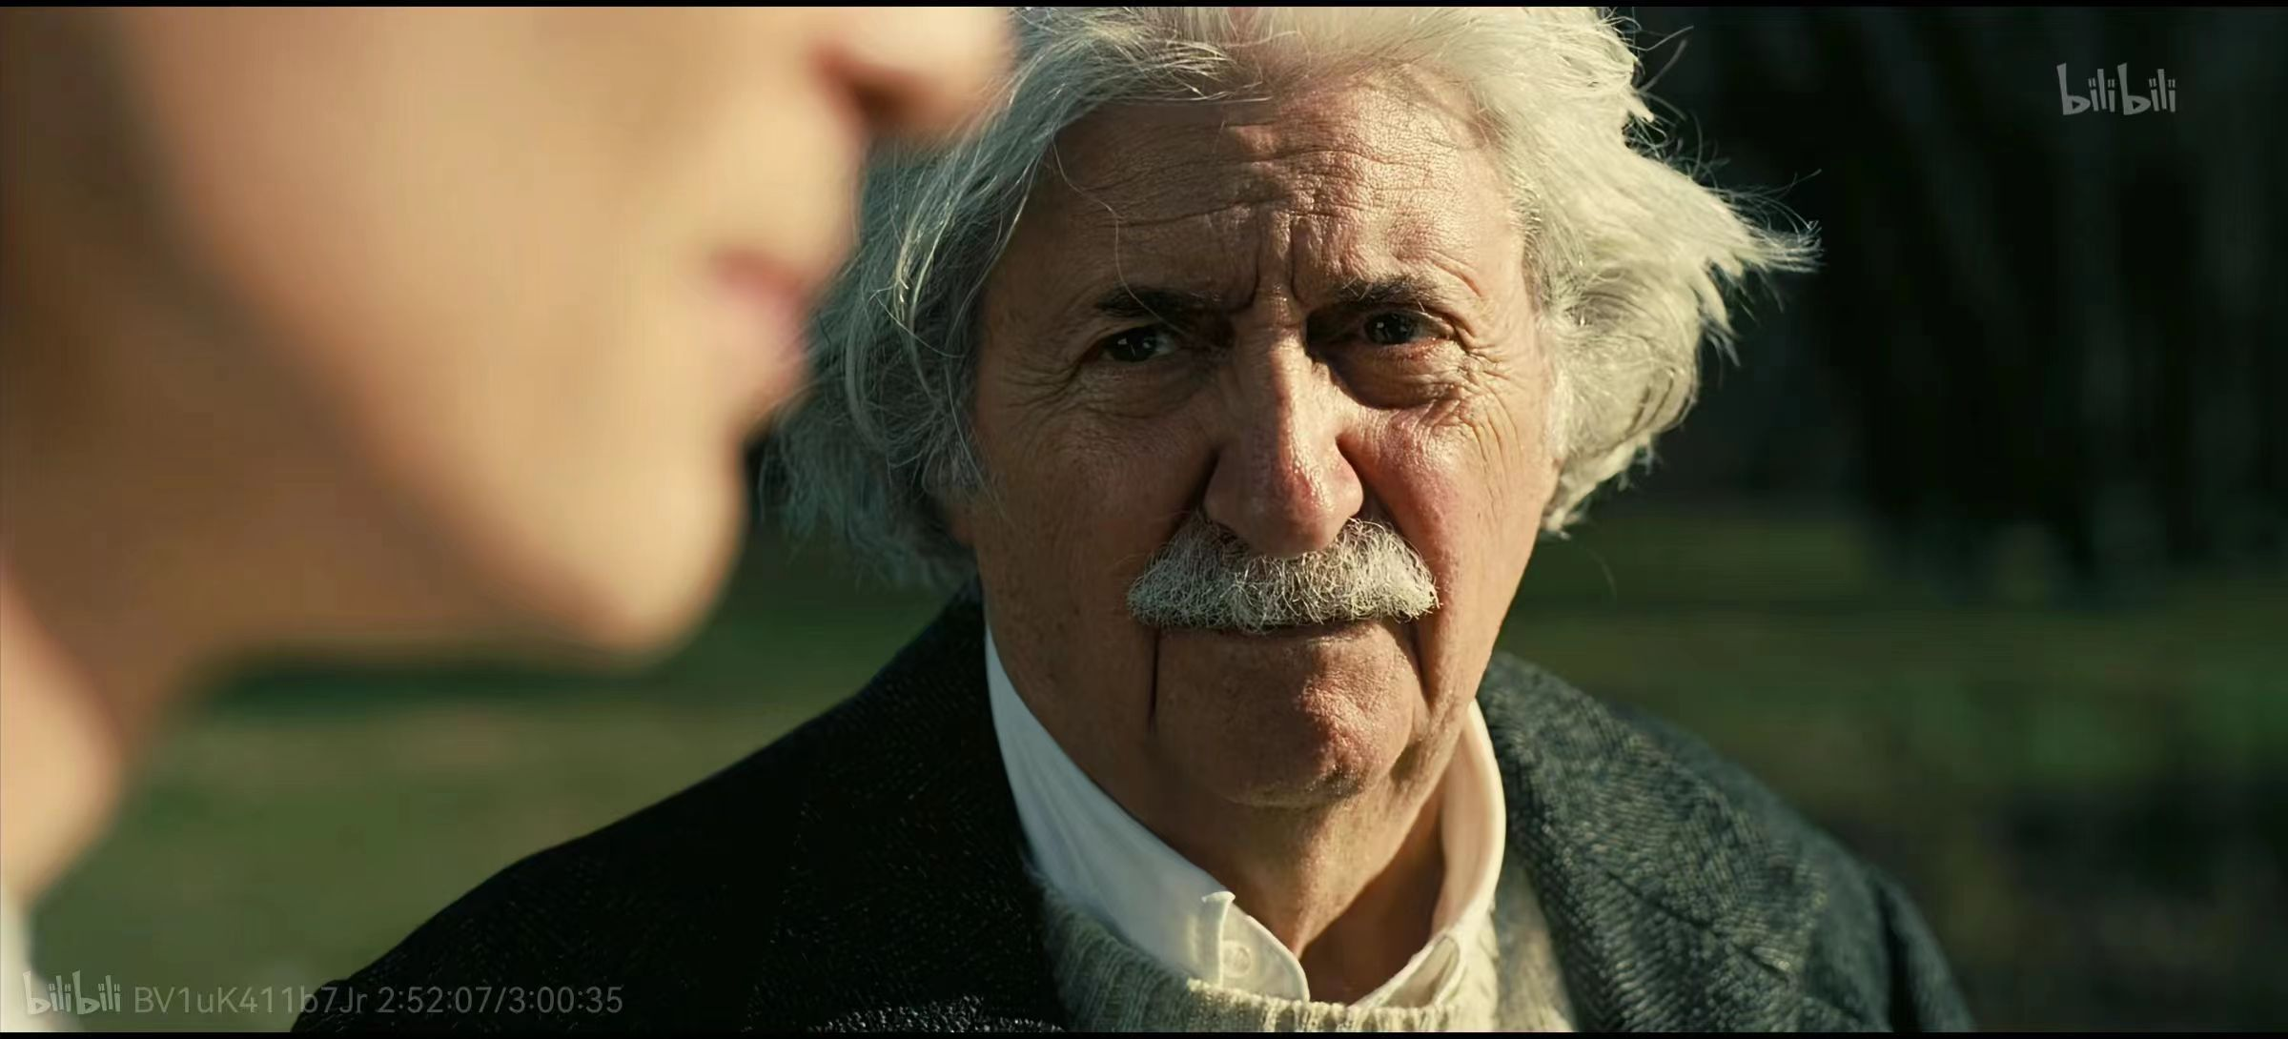
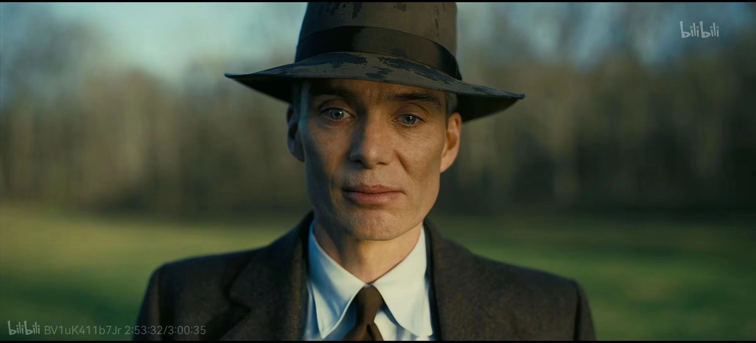
Source of inspiration
Enhance subject and blur background.
pictures from Oppenheimer

Slide 3
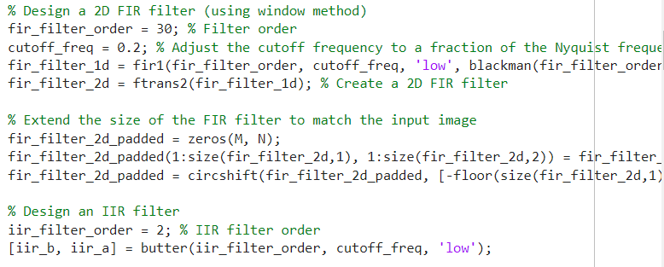
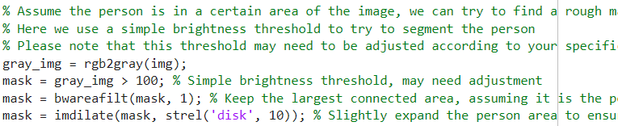
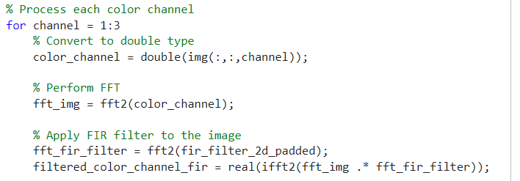
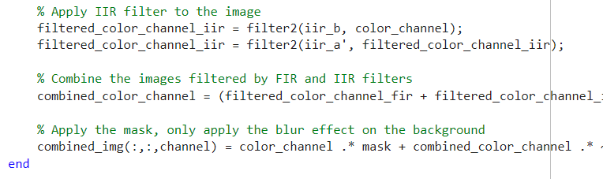
Experiment
step1:Set up a two-dimensional FIR
filter to eliminate noise.
step2: Create a portrait mask to preserve
the portrait information.
step3:Perform IIR filtering on various colors in the background and combine it with the results of FIR filtering to achieve a blurring effect.

Slide 4
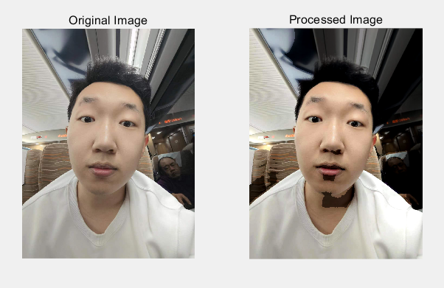
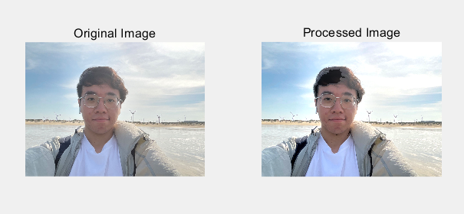
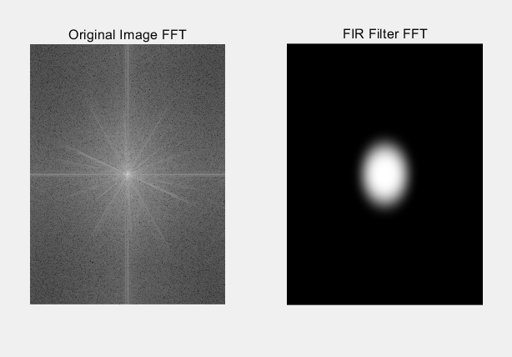
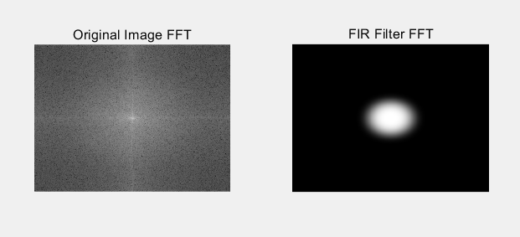
Experimental results
The main subject stands out more clearly √
The background has been blurred√
High frequency
Low frequency

Slide 5
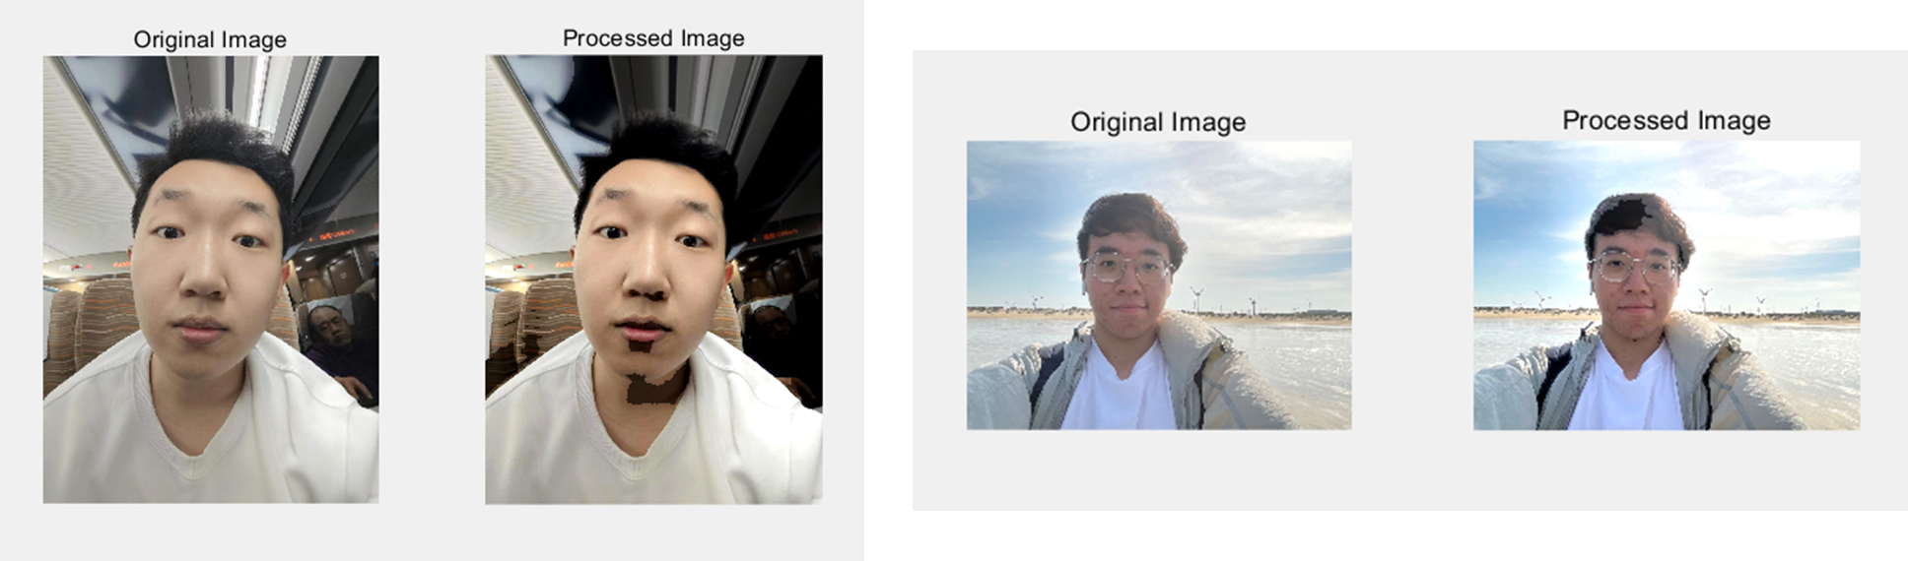
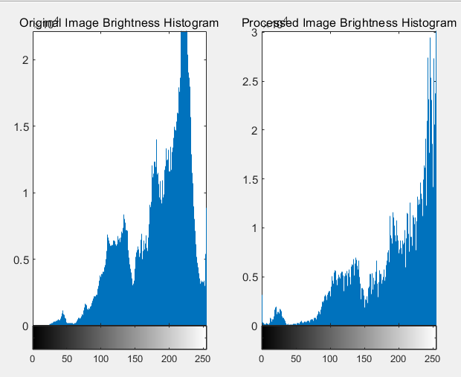
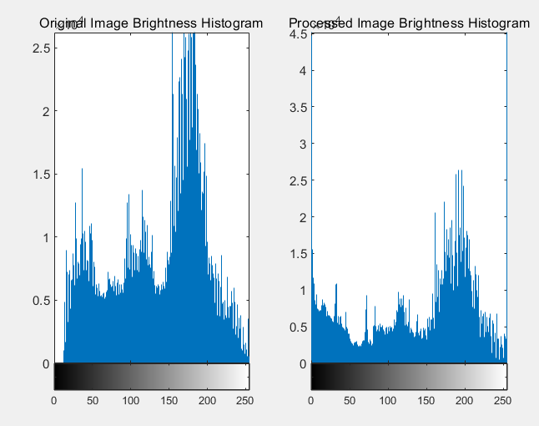
Judging Criteria
——Estimate the aperture value using a brightness histogram
When other conditions are fixed, reducing the aperture value will result in a better bokeh effect, and the overall brightness histogram will shift to the right.

Slide 6
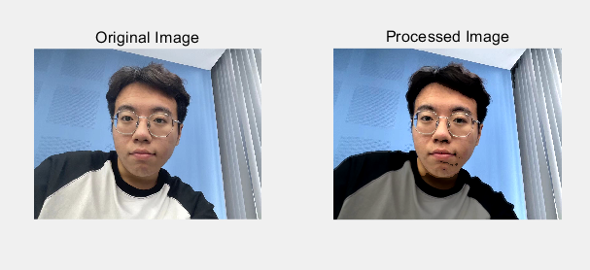


Hassles
Cannot be recognized well……
How to deal with this issue?

Slide 7
Thanks for listening.

